Slide 1
Truthful Mechanism for Facility Allocation:
A Characterization and Improvement of Approximation Ratio
Pinyan Lu, MSR Asia
Yajun Wang, MSR Asia
Yuan Zhou, Carnegie Mellon University
TexPoint fonts used in EMF.
Read the TexPoint manual before you delete this box.: AAAAAAAAAAAA

Slide 2
Problem discussed
Design a mechanism for the following n-player game
  Players is located on a real line
  Each player report their location to the mechanism
  The mechanism decides a new location to build the facility
mechanism g
y
x₁
x₂

Slide 3
Problem discussed (cont’d)
Design a mechanism for the following n-player game
  Players is located on a real line
  Each player report their location to the mechanism
  The mechanism decides a new location to build the facility
For example, the mean func.,
mechanism

Slide 4
Problem discussed (cont’d)
Design a mechanism for the following n-player game
  Players is located on a real line
  Each player report their location to the mechanism
  The mechanism decides a new location to build the facility
For example, the mean func.,
  This encourages Player 1 to report , then becomes closer to Player 1’s real location.
mechanism

Slide 5

Truthfulness
Design a mechanism for the following n-player game
  Players is located on a real line
  Each player report their location to the mechanism
  The mechanism decides a new location to build the facility
Truthful mechanism does not encourage player to report untruthful locations
mechanism

Slide 6
Truthfulness of
Suppose w.l.o.g. that
has no incentive to lie
will not change the outcome of if it misreports a value
If misreports that , then the decision of will be even farther from

Slide 7
Truthfulness of
Suppose w.l.o.g. that
has no incentive to lie
will not change the outcome of if it misreports a value
If misreports that , then the decision of will be even farther from
Corollary: a mechanism which outputs the leftmost (rightmost) location among players is truthful

Slide 8
A natural question
Is there any other (non-trivial) truthful mechanisms? Can we fully characterize the set of truthful mechanisms?
Gibbard-Satterthwaite Theorem. If players can give arbitrary preferences, then the only truthful mechanisms are dictatorships, i.e. for some
In our facility game, since players are not able to give arbitrary preferences, we have a set of richer truthful mechanisms, such as leftmost(rightmost), and …

Slide 9
Even more interesting truthful mechanisms
Mechanism:
Suppose w.l.o.g. that
has no incentive to lie
can change the outcome only when it lies to be where and are on different sides of , but this makes the new outcome farther from
Corollary: outputting the median ( ) is truthful

Slide 10
Social cost and approximation ratio
Good news! Median is truthful!
  Median also optimizes the social cost, i.e. the total distance from each player to the facility
Approximation ratio of mechanism

Slide 11
Approximation ratio of other mechanisms
  Gap instance:
  Gap instance:

Slide 12
Extend to two facility game
Suppose we have more budget, and we can afford building two facilities
Each player’s cost function: its distance to the closest facility
Good truthful approximation?
A simple try
  Mechanism: set facilities on the leftmost and rightmost player’s location

Slide 13
Extend to two facility game
A simple try
  Mechanism: set facilities on the leftmost and rightmost player’s location
  Gap Instance:

Slide 14
Randomized mechanisms
The mechanism selects pair of locations according to some distribution
Each player’s cost function is the expected distance to the closest facility
Does randomness help approximation ratio?

Slide 15
Multiple locations per agent
Agent controls locations
Agent ‘s cost function is
Social cost:
A randomized truthful mechanism
  Given , return with probability
Claim. The mechanism is truthful
Theorem. The mechanism’s approximation ratio is

Slide 16
Summary of questions.
Characterization
  Is there a full characterization for deterministic truthful mechanism in one-facility game?
Approximation
  Upper/lower bound for two facility game in deterministic/randomized case?
  Lower bound for one facility game in randomized case when agents control multiple locations?

Slide 17
Our result and related work
Give a full characterization of one-facility deterministic truthful mechanisms
  Similar result by [Moulin] and [Barbera-Jackson]
Improve the bounds approximation ratio in several extended game settings
  *: Most of previous results are due to [Procaccia-Tennenholtz]
  **: In this setting, each player can control multiple locations
Setting | one facility deterministic | two facilities deterministic | two facilities randomized | one facility, randomized**
Previous known* | 1 vs. 1 | 3/2 vs. n – 1 | ? vs. n – 1 | ? vs. ?
Our result | N/A | 2 vs. n – 1 | 1.045 vs. n – 1 | 1.33 vs. 3
Follow-up result | N/A | Ω(n) vs. n – 1 | 1.045 vs. 4 | N/A

Slide 18
Outline
Characterization of one-facility deterministic truthful mechanisms
Lower bound for randomized two-facility games
Lower bound for randomized one-facility games when agents control multiple locations
Upper bound for randomized two-facility games

Slide 19
The characterization
Generally speaking, the set of one-facility deterministic truthful mechanisms consists of min-max functions (and its variations)
Actually we prove that all truthful mechanism can be written in a standard min-max form with 2^{n} parameters (perhaps with some variation)
med
max
standard form
min
min
med
x₃
med
x₁
x₂
max
x₁
med
x₂
med
med
x₂
med
x₃
c₁
c₁
x₁
c₂
c₃
x₁
c₄
c₅
x₁
c₆
c₇
x₁
c₈

Slide 20
More precise in the characterization
The image set of the mechanism can be an arbitrary closed set
We restrict the min-max function onto by finding the nearest point in
max
min
min
x₁
x₂
max
x₁
x₃
c₁

Slide 21
More precise in the characterization
The image set of the mechanism can be an arbitrary closed set
We restrict the min-max function onto by finding the nearest point in
max
min
min
x₁
x₂
max
x₁
x₃
c₁

Slide 22
More precise in the characterization
The image set of the mechanism can be an arbitrary closed set
We restrict the min-max function onto by finding the nearest point in
  What about when there are 2 nearest points ?
  A tie-breaking gadget takes response of that !
max
min
min
x₁
x₂
max
x₁
x₃
c₁

Slide 23
The proof – warm-up part
Image set of g
Lemma. If is a truthful mechanism, then goes to the closest point in from , for all
Proof. For every ,
Corollary. is closed.
Now, for simplicity, assume

Slide 24
Main lemma
Lemma. For each truthful mechanism , there exists a min-max function , such that is the closest point in from , for all inputs
Proof (sketch). Prove by induction on
  When , should output the closest point in from :
  For

Slide 25
Main lemma
For , define
  Claim 1. is truthful
  Claim 2.
  Claim 3. , as mechanisms for -player game, are truthful
  Claim 4.

Slide 26
Main lemma
Thus,

Slide 27
Main lemma
Thus,

Slide 28
Main lemma
1 player:
2 players:

Slide 29
Main lemma
1 player:
3 players:
2 players:

Slide 30
Main lemma
1 player:
2 players:
3 players:

Slide 31
Main lemma
1 player:
2 players:
3 players:

Slide 32
The reverse direction
Lemma. Every min-max function is truthful
  Observation. To prove a -player mechanism is truthful, only need to prove the -player mechanisms are truthful for every and
Theorem. The characterization is full

Slide 33
Multiple locations per agent
Theorem. Any randomized truthful mechanism of the one facility game has an approximation ration at least 1.33 in the setting that each agent controls multiple locations.
Theorem (weaker). Any randomized truthful mechanism of the one facility game has an approximation ration at least 1.2 in the setting that each agent controls multiple locations.

Slide 34
Multiple locations per agent (cont’d)
Player 1
Player 2
Proof. (weaker version)
Instance 1
Instance 2
Instance 3
For Player 1 at Instance 1 (compared to Instance 2)
For Player 1
For Player 2 at Instance 3 (compared to Instance 2)
For Player 2

Slide 35
Multiple locations per agent (cont’d)
Player 1
Player 2
Proof. (weaker version)
Instance 1
Instance 2
Instance 3
For Player 1
For Player 2
Assume <1.2 approx.
For Inst. 1
For Inst. 2
For Inst. 3

Slide 36
Multiple locations per agent (cont’d)
Player 1
Player 2
Proof. (weaker version)
Instance 1
Instance 2
Instance 3
For Player 1
1.6 <
< 1.6
For Player 2
Assume <1.2 approx.
Contradiction
For Inst. 1
For Inst. 2
For Inst. 3

Slide 37
Multiple locations per agent (cont’d)
Player 1
Player 2
Proof. (stronger version)
Instance 1
Instance 2
Instance 3
Instance 4
Instance 5

Slide 38
Multiple locations per agent (cont’d)
Player 1
Player 2
Proof. (stronger version)
Instance
Instance
Instance

Slide 39
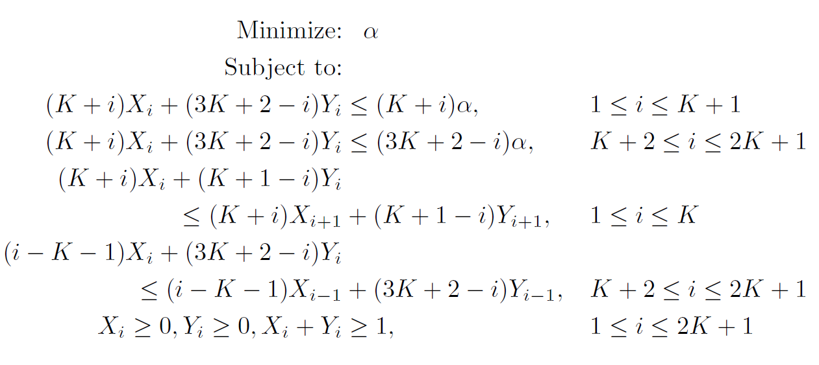
Multiple locations per agent (cont’d)
Linear Programming
Take

Slide 40
Lower bound for 2-facility randomized case
Theorem. For any 2-facility randomized truthful mechanism, the approximation ratio is at least a , where is the number of players
Proof
  Consider instance : player at , players at , player at
  For mechanisms within 2-approx. :
  Assume w.l.o.g.:

Slide 41
Lower bound for 2-facility randomized case
Theorem. For any 2-facility randomized truthful mechanism, the approximation ratio is at least a , where is the number of players
Proof
  Consider instance : player at , players at , player at
  Another instance : player at , players at , player at

Slide 42
Lower bound for 2-facility randomized case
Theorem. For any 2-facility randomized truthful mechanism, the approximation ratio is at least a , where is the number of players
Proof
  Consider instance : player at , players at , player at
  Another instance : player at , players at , player at
  By truthfulness:

Slide 43
Lower bound for 2-facility randomized case
Theorem. For any 2-facility randomized truthful mechanism, the approximation ratio is at least a , where is the number of players
Proof

Slide 44
Lower bound for 2-facility randomized case
Theorem. For any 2-facility randomized truthful mechanism, the approximation ratio is at least a , where is the number of players
Proof
Done.

Slide 45
A 4-approx. randomized mechanism for 2-facility game
Mechanism. Choose by random, then choose with probability
set two facilities at
Truthfulness: only need to prove the following 2-facility mechanism is truthful
  Set one facility at , and the other facility at with probability

Slide 46
Proof of truthfulness
Truthfulness: only need to prove the following 2-facility mechanism is truthful
  Set one facility at , and the other facility at with probability
Proof. For player ,
when misreporting to ,
S
A
b
S
b
b’
A
b’

Slide 47
Proof of truthfulness (cont’d)
Truthfulness: only need to prove the following 2-facility mechanism is truthful
  Set one facility at , and the other facility at with probability
Proof.

Slide 48
Approximation ratio
Claim. The mechanism approximates the optimal social cost within a factor of 4.
Intuition
  When locations are “sparse”, opt is also bad
  When locations fall into two groups, opt is small, but Mechanism behaves very similar to opt

Slide 49
Open problems
Characterization
  Deterministic 2-facility game?
  Randomized 1-facility game?
Approximation
  Still some gaps…
  Randomized 3-facility game?

Slide 50
Thank you!

