Slide 1
Understanding the Power of Convex Relaxation Hierarchies: Effectiveness and Limitations
Yuan Zhou
Computer Science Department
Carnegie Mellon University

Slide 2
Combinatorial Optimization
Goal: optimize an objective function of n 0-1 variables
Subject to: certain constraints
Arises everywhere in Computer Science, Operations Research, Scheduling, etc

Slide 3
Example 1: MaxCut
Input: graph G = (V, E)
Goal: partition V into two parts A & B
such that edges(A, B) is maximized
Can also be formulated as
Maximize objective ,
where x_{i}’s are 0-1 variables
A fundamental (and very easily stated) combinatorial optimization problem
A
B=V-A
number of edges between A & B
G=(V,E)

Slide 4
Example 2: SparsestCut
Input: graph G = (V, E)
Goal: partition V into two parts A & B
such that the sparsity is minimized
Closely related to the NormalizedCut problem in Image Segmentation
A
B=V-A
G=(V,E)
=
+
+
+
+
Pictures from [ShiMalik00]

Slide 5
Convex relaxations
Most optimization problems are NP-hard to compute the exact optimum
Various approaches to approximate the optimal solution: greedy, heuristics, convex relaxations

Slide 6
Convex relaxations
Linear programming(LP)/semidefinite programming(SDP) relaxations
SDP: “super LP”, computational tractable
Integer program of optimization problems
(NP-hard)
relax the constraints
Convex program – LP/SDP
(computational tractable)
solve
approximate
Optimal solution to the convex program

Slide 7
Convex relaxations
Linear programming(LP)/semidefinite programming(SDP) relaxations
Focus of this talk: LP/SDP relaxation hierarchies
A sequence of more and more powerful relaxations
Extremely successful to approximate the optimum
Imply almost all known approximation algorithms
…
Relaxation #1 #2 #3 #4

Slide 8
Outline of my research on hierarchies
Introduction for convex relaxation hierarchies
Use hierarchies to design approximation algorithms
dense MaxCut, dense k-CSP, metric MaxCut, locally-dense k-CSP, dense MaxGraphIsomorphism, (dense & metric) MaxGraphIsomorphism [Yoshida-Zhou’14]
What problems are resistant to hierarchies – the limitation of hierarchies?
SparsestCut [Guruswami-Sinop-Zhou’13], DensekSubgraph [Bhaskara-Charikar-Guruswami-Vijayaraghavan-Zhou’12], GraphIsomorphism [O’Donnell-Wright-Wu-Zhou’14]
New perspective for hierarchy
Connection from theory of algebraic proof complexity
New insight to the big open problem in approximation algorithms
[Barak-Brandão-Harrow-Kelner-
Steurer-Zhou’12, O’Donnell-Zhou’13, …]

Slide 9
Outline of this talk
Introduction for convex relaxation hierarchies
Use hierarchies to design approximation algorithms
dense MaxCut, dense k-CSP, metric MaxCut, locally-dense k-CSP, dense MaxGraphIsomorphism, (dense & metric) MaxGraphIsomorphism [Yoshida-Zhou’14]
What problems are resistant to hierarchies – the limitation of hierarchies?
SparsestCut [Guruswami-Sinop-Zhou’13], DensekSubgraph [Bhaskara-Charikar-Guruswami-Vijayaraghavan-Zhou’12], GraphIsomorphism [O’Donnell-Wright-Wu-Zhou’14]
New perspective for hierarchy
Connection from theory of algebraic proof complexity
New insight to big open problem in approximation algorithms

Slide 10
Writing linear programming (LP) relaxations
x+y=1
(0, 1)
(1, 1)
Toy problem #1: Integer Program
(0, 0)
(1, 0)
True Optimum : 1

Slide 11
Writing linear programming (LP) relaxations
3
x+y=
x+y=1
2
(0, 1)
(1, 1)
Toy problem #1: Integer Program
LP relaxation
(3/4,3/4)
(0, 0)
(1, 0)
Typical way of approximating the true optimum
Analysis of approx. ratio needs to understand the extra sol. introduced
Integrality gap (IG) =
“2/3-approximation”
closer to 1,
better approx.
True Optimum : 1
= 2/3
[0,1]
Relaxation Optimum : 3/2
This example is credited to Madhur Tulsiani.

Slide 12
Writing semidefinite programming (SDP) relaxations
Toy problem #2: MaxCut on a triangle
SDP relaxation
x
y
z
True Optimum : 2
0
Integers
relaxed to vectors

Slide 13
Writing semidefinite programming (SDP) relaxations
Toy problem #2: MaxCut on a triangle
SDP relaxation
Integrality gap (IG) = ≈ .889
Can write similar SDP relaxations for every MaxCut instance
Integrality gap might be worse
[Goemans-Williamson’95] IG > .878 for every MaxCut instance
x
O
: BasicSDP
y
z
True Optimum : 2
Relaxation Optimum : 9/4

Slide 14
Tighten the relaxations
Toy problem #2: MaxCut on a triangle
BasicSDP relaxation
Integrality gap (IG) = = 1
x
✗
O
with triangle inequalities
y
z
Do triangle ineq.’s always improve the BasicSDP in the worst cases?
[Khot-Vishnoi’05] No. The worst-case integrality gap is still ≈ .878
True Optimum : 2
Relaxation Optimum : 2

Slide 15
Tighten the relaxations
[Khot-Vishnoi’05] Triangle ineq.’s do not improve the worst-case integrality gap for MaxCut
In many occasions, triangle ineq.’s do help
Famous example of SparsestCut on an n-vertex graph
IG of BasicSDP:
IG after triangle ineq.’s: [Arora-Rao-Vazirani’04]
Can add even more constraints, leading to even better approximation guarantee

Slide 16
LP/SDP relaxation hierarchies
Automatic ways to generate more and more variables & constraints, leading to tighter and tighter relaxations
(0, 1)
(1, 1)
(0, 0)
(1, 0)

Slide 17
LP/SDP relaxation hierarchies
Automatic ways to generate more and more variables & constraints, leading to tighter and tighter relaxations
(0, 1)
(1, 1)
(0, 0)
(1, 0)

Slide 18
LP/SDP relaxation hierarchies
Automatic ways to generate more and more variables & constraints, leading to tighter and tighter relaxations
(0, 1)
(1, 1)
(0, 0)
(1, 0)

Slide 19
LP/SDP relaxation hierarchies
Automatic ways to generate more and more variables & constraints, leading to tighter and tighter relaxations
Start from the BasicRelaxation; power of the
program increases as the level goes up
Hierarchies studied in Operations Research
Lovász-Schrijver LP (LS)
Sherali-Adams (SA LP, SA+ SDP)
Lasserre-Parrilo SDP (Las)
BasicRelaxation (Level-1)
(0, 1)
(1, 1)
(0, 0)
(1, 0)
Level-2
Level-3

Slide 20
LP/SDP relaxation hierarchies
Automatic ways to generate more and more variables & constraints, leading to tighter and tighter relaxations
Start from the BasicRelaxation; power of the
program increases as the level goes up
Hierarchies studied in Operations Research
Lovász-Schrijver LP (LS)
Sherali-Adams (SA LP, SA+ SDP)
Lasserre-Parrilo SDP (Las)
LS^{(k)}
≥
SA^{(k)}
≥
SA+^{(k)}
≥
Las^{(k)}

Slide 21
LP/SDP relaxation hierarchies
Automatic ways to generate more and more variables & constraints, leading to tighter and tighter relaxations
Start from the BasicRelaxation; power of the
program increases as the level goes up
Hierarchies studied in Operations Research
Lovász-Schrijver LP (LS)
Sherali-Adams (SA LP, SA+ SDP)
Lasserre-Parrilo SDP (Las)
Powerful algorithmic framework capturing most
known approximation algorithms within constant levels
E.g. Arora-Rao-Vazirani algorithm
At Level-k:
n^{O(k)} var.’s,
solvable in n^{O(k)} time
Level-n tight
(n: input size)
LS^{(k)}
≥
SA^{(k)}
≥
SA+^{(k)}
≥
Las^{(k)}

Slide 22
Outline of this talk
Introduction for convex relaxation hierarchies
Use hierarchies to design approximation algorithms
dense MaxCut, dense k-CSP, metric MaxCut, locally-dense k-CSP, dense MaxGraphIsomorphism, (dense & metric) MaxGraphIsomorphism [Yoshida-Zhou’14]
What problems are resistant to hierarchies – the limitation of hierarchies?
SparsestCut [Guruswami-Sinop-Zhou’13], DensekSubgraph [Bhaskara-Charikar-Guruswami-Vijayaraghavan-Zhou’12], GraphIsomorphism [O’Donnell-Wright-Wu-Zhou’14]
New perspective for hierarchy
Connection from theory of algebraic proof complexity
New insight to big open problem in approximation algorithms

Slide 23
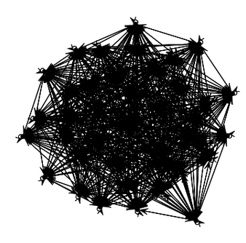
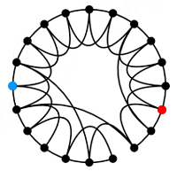
Our results: Sherali-Adams LP hierarchy for dense MaxCut
General MaxCut
.878-approximable by SDP [Goemans-Williamson’95]
NP-hard to .941-approximate [Håstad’01, TSSW’00]
Theorem. [Yoshida-Zhou’14] For dense MaxCut, Sherali-Adams LP hierarchy approximates the optimum arbitrarily well in constant level (polynomial-time)
Integrality gap of level-O(1/ε²) Sherali-Adams LP is (1-ε) for dense MaxCut for any constant ε
Graph with n vertices has at most n² edges
Say it’s dense if it has at least .01n² edges
dense
sparse

Slide 24
Our results: summary
Within a few levels, Sherali-Adams LP hierarchy arbitrarily well approximates
dense MaxCut
dense k-CSP
metric MaxCut
locally-dense k-CSP
dense MaxGraphIsomorphism
(dense & metric) MaxGraphIsomorphism
Although many of our algorithmic results were known via other techniques…
Our results show that Sherali-Adams LP hierarchy is a unified approach implying all previous techniques!
Although
[dlV’96] via sampling and exhaustive search
[FK’96] via weak Szemerédi’s regularity lemma
[dlVK’01] via copying important variables
[dlVKKV’05] via a variant of SVD
[AFK’02] via LP relaxation for “assignment problems with extra constraints”
(New, not known before)

Slide 25
Outline of this talk
Introduction for convex relaxation hierarchies
Use hierarchies to design approximation algorithms
dense MaxCut, dense k-CSP, metric MaxCut, locally-dense k-CSP, dense MaxGraphIsomorphism, (dense & metric) MaxGraphIsomorphism [Yoshida-Zhou’14]
What problems are resistant to hierarchies – the limitation of hierarchies?
SparsestCut [Guruswami-Sinop-Zhou’13], DensekSubgraph [Bhaskara-Charikar-Guruswami-Vijayaraghavan-Zhou’12], GraphIsomorphism [O’Donnell-Wright-Wu-Zhou’14]
New perspective for hierarchy
Connection from theory of algebraic proof complexity
New insight to big open problem in approximation algorithms

Slide 26
Limitations of hierarchies
We will prove theorems in the following style
Fix a problem (e.g. MaxCut), even using many levels (e.g. >100, >log n, >.1n) of the hierarchy, the integrality gap is still bad
Design a (MaxCut) instance I
Prove real MaxCut of I small
Prove relaxation thinks MaxCut of I large
I.e. the hierarchy does not
give good approximation
want it far from 1
Integrality gap (IG) =
True Optimum : 2
Relaxation Optimum : 9/4
≈ .889

Slide 27
Motivation
The big open problem in approximation algorithms research
Is it NP-hard to beat .878-approximation for MaxCut (Goemans-Williamson SDP)?
I.e. is Goemans-Williamson SDP optimal?

Slide 28
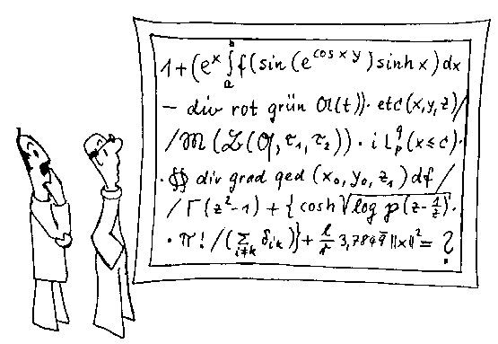
Motivation
Big open problem
NP-hardness of beating .878-approximation for MaxCut (Goemans-Williamson SDP)?
Why?
Mysterious true answer
(If no) better algorithm, disprove Unique Games Conjecture
(If yes) optimality of BasicSDP (for many problems), connect geometry and computation
How?
Hmm… we are working on it

Slide 29
Motivation
Big open problem
NP-hardness of beating .878-approximation for MaxCut (Goemans-Williamson SDP)?
Why?
Mysterious true answer
(If no) better algorithm, disprove Unique Games Conjecture
(If yes) optimality of BasicSDP (for many problems), connect geometry and computation
How?
Hmm… we are working on it
What to do instead/as a first step
Whether our most powerful algorithms (hierarchies) fail to beat the Goemans-Williamson SDP?
Why?
Predicts the true answer
(If no) better algorithm, disprove Unique Games Conjecture
(If yes) BasicSDP optimal in a huge class of convex relaxations
New ways of reasoning about convex relaxation hierarchies

Slide 30
Limitations for hierarchies
Recall: Lasserre-Parrilo – strongest hierarchy known
Have seen a few levels (O(1)) of
Sherali-Adams LP hierarchy already powerful
Will prove limitations of the Lasserre-
Parrilo SDP hierarchy with many levels (n^{.01})
for several problems
Predict the NP-hardness of approximating
these problems
At least substantially new algorithmic ideas needed
LS^{(k)}
≥
SA^{(k)}
≥
SA+^{(k)}
≥
Las^{(k)}

Slide 31
Our results: SparsestCut & DensekSubgraph
Theorem. [Guruswami-Sinop-Zhou’13] 1.0001-factor integrality gap of Ω(n)-level Lasserre-Parrilo for SparsestCut
Theorem. [Bhaskara-Charikar-Guruswami-Vijayaraghavan-Zhou’12] n^{2/53}-factor integrality gap of Ω(n^{.01})-level Lasserre-Parrilo for DensekSubgraph
DensekSubgraph: Given graph G=(V, E), find a set A of k vertices such that the number of edges in A is maximized
Frequently arises in community detection (social networks)
Problem | Best Approx. Alg | Best NP-Hardness | Our IG
SparsestCut | [ARV’04] | None known | 1.0001

Slide 32
Our results: SparsestCut & DensekSubgraph
Theorem. [Guruswami-Sinop-Zhou’13] 1.0001-factor integrality gap of Ω(n)-level Lasserre-Parrilo for SparsestCut
Theorem. [Bhaskara-Charikar-Guruswami-Vijayaraghavan-Zhou’12] n^{2/53}-factor integrality gap of Ω(n^{.01})-level Lasserre-Parrilo for DensekSubgraph
DensekSubgraph: Given graph G=(V, E), find a set A of k vertices such that the number of edges in A is maximized
Frequently arises in community detection (social networks)
Problem | Best Approx. Alg | Best NP-Hardness | Our IG
SparsestCut | [ARV’04] | None known | 1.0001
DensekSubgraph | [BCCFV’10] | None known | n^{2/53}

Slide 33
Our results: GraphIsomorphism
Isomorphic graphs
Non-isomorphic graphs

Slide 34
Our results: GraphIsomorphism
Sherali-Adams LP hierarchy for GraphIsomorphism (GIso)
A.k.a. high dimensional color refinement/Weisfeiler-Lehman alg.
A widely used heuristic
A subroutine of Babai-Luks - time GIso algorithm
Once conjectured: O(1)-level Sherali-Adams LP solves GIso
Refuted by [Cai-Fürer-Immerman’92]: Even .1n-level Sherali-Adams LP says isomorphic, the two graphs might be non-isomorphic
Theorem. [O’Donnell-Wright-Wu-Zhou’14] Even .1n-level Lasserre-Parrilo SDP says isomorphic, the two graphs might be far from being isomorphic
i.e. one has to modify Ω(1)-fraction edges to align the graphs

Slide 35
Outline of this talk
Introduction for convex relaxation hierarchies
Use hierarchies to design approximation algorithms
dense MaxCut, dense k-CSP, metric MaxCut, locally-dense k-CSP, dense MaxGraphIsomorphism, (dense & metric) MaxGraphIsomorphism [Yoshida-Zhou’14]
What problems are resistant to hierarchies – the limitation of hierarchies?
SparsestCut [Guruswami-Sinop-Zhou’13], DensekSubgraph [Bhaskara-Charikar-Guruswami-Vijayaraghavan-Zhou’12], GraphIsomorphism [O’Donnell-Wright-Wu-Zhou’14]
New perspective for hierarchy
Connection from theory of algebraic proof complexity
New insight to big open problem in approximation algorithms

Slide 36
Hierarchy integrality gaps for MaxCut
Recall
Big open problem
Is Goemans-Williamson SDP the best
polynomial-time algorithm for MaxCut?
As the first step
Do hierarchies give .879-approximation
(Beat Goemans-Williamson)?
Known results for Sherali-Adams+ SDP [KV’05, RS’09, BGHMRS’12]
Level- SA+ SDP do not .879-approximate MaxCut
I.e. Exists MaxCut instances hard for SA+ SDP (integrality gap)
Hardest instances known for MaxCut
LS^{(k)}
≥
SA^{(k)}
≥
SA+^{(k)}
≥
Las^{(k)}

Slide 37
Applying Lasserre-Parrilo to hard instances for Sherali-Adams+ SDP
Known results. Instances hard for Sherali-Adams+
SDP hierarchy
Question. Are these MaxCut instances also
.878-integrality gap instances for Lasserre-Parrilo
SDP hierarchy?
Our answer. No!
Theorem. [Barak-Brandão-Harrow-Kelner-
Steurer-Zhou’12, O’Donnell-Zhou’13] O(1)-level
Lasserre-Parrilo gives better-than-.878 approximation to these MaxCut instances
LS^{(k)}
≥
SA^{(k)}
≥
SA+^{(k)}
≥
Las^{(k)}

Slide 38
Why is this interesting?
Lasserre-Parrilo succeeds on the hardest known
MaxCut instances, with the potential to work for
all MaxCut instances
Seriously questions possible optimality of GW
LS^{(k)}
≥
SA^{(k)}
≥
SA+^{(k)}
≥
Las^{(k)}

Slide 39
Why is this interesting?
The big open question:
Is Goemans-Williamson the best polynomial-time algorithm for MaxCut?
Evidence for Yes
[KV’05, RS’09, BGHMRS’12]
GW is optimal in Sherali-Adams+ hierarchy
Evidence for No
(our results)
Hard instances from the left are solved by Lasserre-Parrilo

Slide 40
Why is this interesting?
Lasserre-Parrilo succeeds on the hardest known
MaxCut instances, with the potential to work for
all MaxCut instances
Seriously questions possible optimality of GW
Separates Lasserre-Parrilo from Sherali-Adams+
Our proof technique
A surprising connection from theory of algebraic
proof complexity
LS^{(k)}
≥
SA^{(k)}
≥
SA+^{(k)}
≥
>
Las^{(k)}

Slide 41
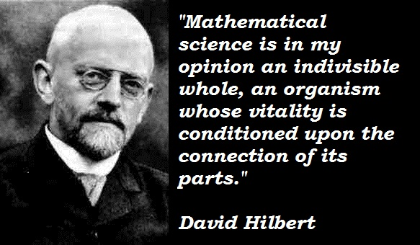
The connection from algebraic proof complexity
We relate power of Lasserre-Parrilo to power of an algebraic proof system –
Sum-of-Squares (SOS) proof system
Proof system where the only way to deduce inequality is by p(x)² ≥ 0
Dates back to Hilbert’s 17th Problem
Given a multivariate polynomial that takes only non-negative values over reals, can it be represented as a sum of squares of rational functions?

Slide 42
Our proof method
Recall: how to prove integrality gaps for MaxCut
Design a MaxCut instance I
Prove real MaxCut of I small
Prove relaxation thinks MaxCut
of I large
Our goal. Prove I is not Lasserre-Parrilo SDP integrality gap instance
Prove Lasserre-Parrilo SDP certifies MaxCut of I small
Our method. By the weak duality theorem for SDPs (primal optimum ≤ any dual solution), design a dual solution with small objective value
want it far from 1
Integrality gap (IG) =
True Optimum : 2
Relaxation Optimum : 9/4
≈ .889

Slide 43
Algebraic proof systems – a new perspective for Lasserre-Parrilo
Our method. Design a dual solution with small objective value
What is Lasserre-Parrilo SDP? – Omitted due to time constraints…
What is the dual SDP of Lasserre-Parrilo?
Our key observation. (new view of the dual)
SOS proof ⬄ dual solution
i.e. SOS proof of MaxCut is small ⬄ dual value small
Our goal. Translate
the proof into SOS proof
system
Proofs of the known MaxCut IG [KV’05]
Design a MaxCut instance I
Prove real MaxCut of I small
Prove relaxation thinks MaxCut
of I large

Slide 44
A comparison
Construct integrality gaps
Can use all mathematical proof techniques
Give a deep proof
to a deep theorem
Our goal
Can only use the limited axioms
(as given by the SOS proof system)
Give a “simple”(restricted) proof
to a deep theorem
Prove the MaxCut of the instance I is at most β
What is the Sum-of-Squares (SOS) proof system?

Slide 45
Example of Sum-of-Squares proof system
Goal: assume , prove
Step 1: turn to refute
Step 2: assume there were a solution
Step 3: come up with the following identity
Step 4: contradiction
A degree-2 SOS proof
non-negative
squared polynomial

Slide 46
Another example: MaxCut on triangle graph
x
To prove MaxCut at most 2
Step 1: turn to refute (for any ε > 0)
Step 2: assume there were a solution
Step 3:
Step 4: contradiction
Degree-4 SOS proof
y
z
non-negative
squared polynomials
0 =

Slide 47
Lasserre-Parrilo and the Sum-of-Squares proof system
Degree-d (for constant d) SOS proof found by an SDP in n^{O(d)} time
Key observation.
degree-d SOS proof ⬄ solution of dual of level-d Lasserre-Parrilo
dual of Lasserre-Parrilo

Slide 48
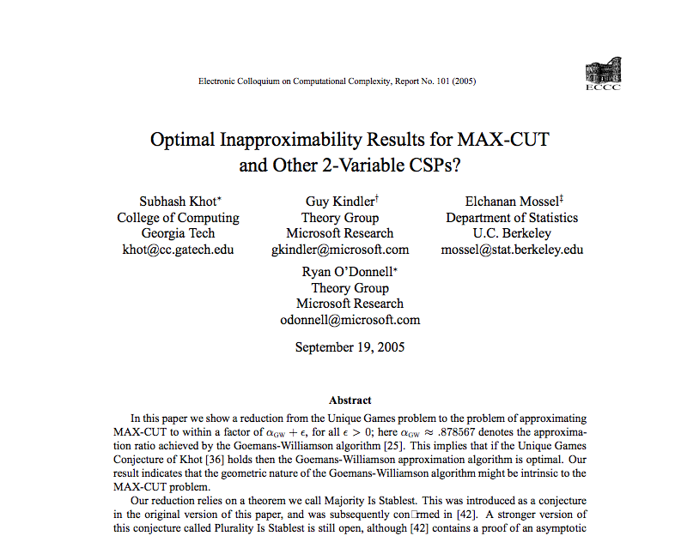
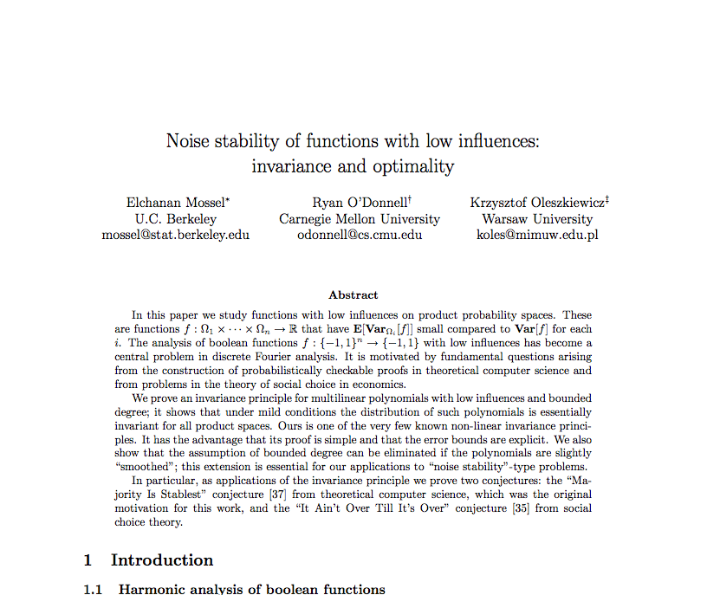
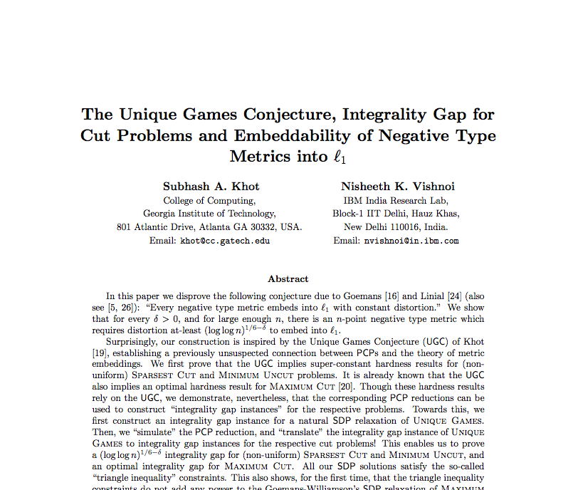
Lasserre-Parrilo succeeds on known MaxCut instances: one-slide proof
38 pages
✗
Theorem. MaxCut of this graph
is ≤ blah
Proof. …Influence Decoding…
…Invariance Principle…
…Majority-Is-Stablest…
…Smallset Expansion…
…Hypercontractivity…
40 pages
52 pages
Our new proof.
“Check out these polynomials.”
However, giving elementary proofs to deep theorems is more challenging and needs new mathematical ideas.

Slide 49
Other works along this line
[De-Mossel-Neeman’13] O(1)-level Lasserre-Parrilo almost exactly computes the optimum of the known MaxCut instances
Improves our work [O’Donnell-Zhou’13] which states that Lasserre-Parrilo gives better-than-.878 approximation
[Barak-Brandão-Harrow-Kelner-Steurer-Zhou’12] O(1)-level Lasserre-Parrilo succeeds on all known UniqueGames instances
[O’Donnell-Zhou’13] O(1)-level Lasserre-Parrilo succeeds on the known BalancedSeparator instances
[Kauers-O’Donnell-Tan-Zhou’14] O(1)-level Lasserre-Parrilo succeeds on the hard instances for 3-Coloring
Central problem in approximation algorithms
A similar problem to SparsestCut

Slide 50
Summary
We utilize the connection between convex programming relaxations and theory of algebraic proof complexity
Lasserre-Parrilo solves the hardest known instances for MaxCut, UniqueGames, BalancedSeparator, 3-Coloring, …
Motivates study of SOS proof system to further understand power of Lasserre-Parrilo
Optimality of BasicSDP (Goemans-Williamson) seems more mysterious

Slide 51
Future directions
Maybe No?
Lasserre-Parrilo better approximation for all MaxCut instances?
We made initial step towards this direction
Maybe Yes?
We gave insight in designing integrality gap
instances: avoid the power of SOS proof system!
The big open question:
Is Goemans-Williamson the best polynomial-time algorithm for MaxCut?
Our first step:
Is Goemans-Williamson the best in Lasserre-Parrilo hierarchy?

Slide 52
Future directions
Concrete open problem. Does level-2 Lasserre-Parrilo improve Goemans-Williamson?
Other future directions
Improve our integrality gap theorems for SparsestCut and DensekSubgraph
Beyond worst-case analysis via Lasserre-Parrilo
Real-world instances
Random instances
Initial results (for 2->4 MatrixNorm problem) in [Barak-Brandão-Harrow-Kelner-Steurer-Zhou’12]

Slide 53
The End
Thanks!

Slide 54
Questions?

